Slide 1
An Analysis of Significant Earthquakes and Volcanic Eruptions
(1900 to 2018)
Aparna, Chloe, BJ and Adote
Notes:
Aparna Present

Slide 2
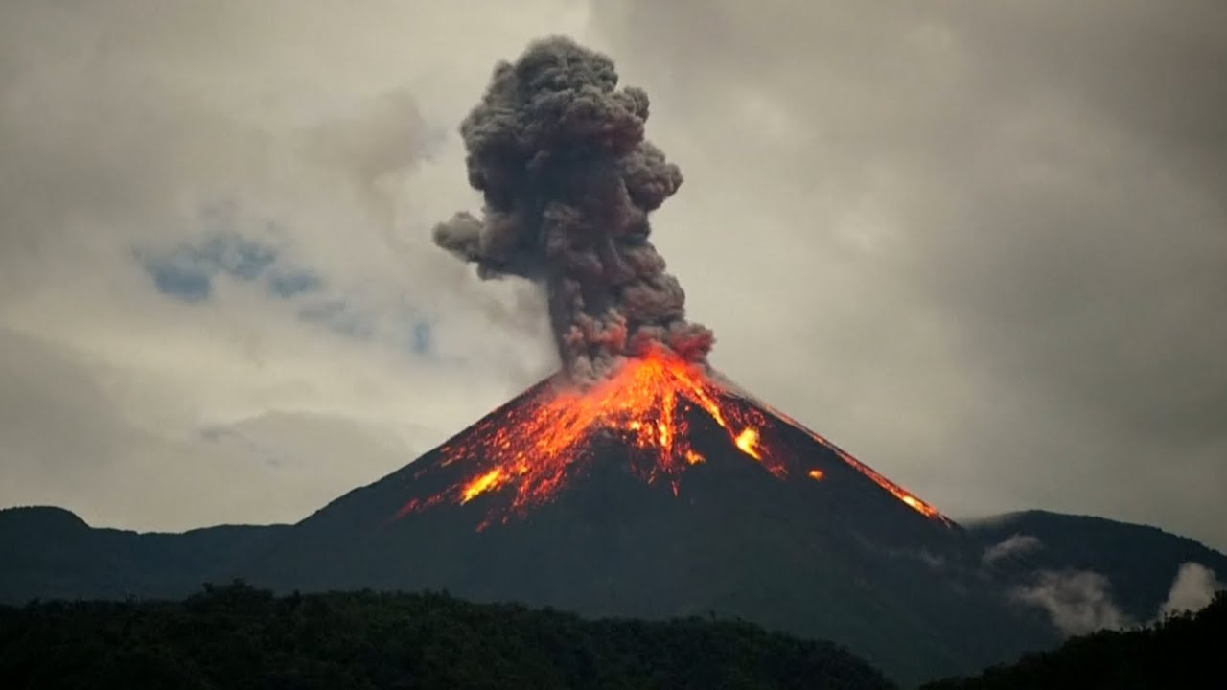
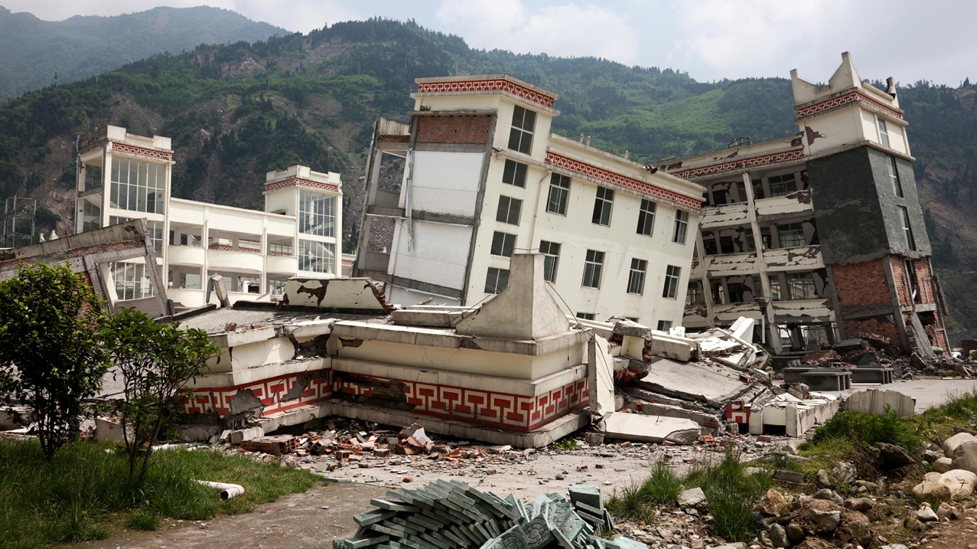
EARTHQUAKE
VOLCANIC ERUPTION

Slide 3
Purpose
Natural disasters have been occurring a lot recently with hurricanes, volcanic eruptions, tsunamis and earthquakes
Can cause great harm and majorly affect people’s lives
Wanted to understand more about the recent history of significant disasters that have occured around the world
Notes:
Chloe Present

Slide 4
Questions Analyzed
Which countries had the most earthquakes/ volcanic eruptions between 1900 to 2018?
What decade had the most earthquakes/ volcanic eruptions?
Which decade had the most deaths caused by these disasters?
How are earthquake magnitude and damage ($) related?
Where do earthquakes and volcanic eruptions happen around the world?
Which states had the most disasters in the US from 1900 to 2018?
Notes:
Aparna

Slide 5
Data Sources
Data Source: NOAA’s National Centers for Environmental Information (NCEI)
Earthquakes Data: National Geophysical Data Center / World Data Service (NGDC/WDS): Significant Earthquake Database. National Geophysical Data Center, NOAA
Volcanic Eruptions Data: National Geophysical Data Center / World Data Service (NGDC/WDS): Significant Volcanic Eruptions Database. National Geophysical Data Center, NOAA.
Period Analyzed: 1900 to 2018
Total Earthquakes: 3603
Total Volcanic Eruptions: 458
Notes:
Chloe Present
*The Significant Earthquake Database contains information on destructive earthquakes from 2150 B.C. to the present that meet at least one of the following criteria: Moderate damage (approximately $1 million or more), 10 or more deaths, Magnitude 7.5 or greater, Modified Mercalli Intensity X or greater, or the earthquake generated a tsunami.
**A significant eruption is classified as one that meets at least one of the following criteria: caused fatalities, caused moderate damage (approximately $1 million or more), with a Volcanic Explosivity Index (VEI) of 6 or larger, caused a tsunami, or was associated with a major earthquake.

Slide 6


Data Exploration
Notes:
Chloe Present

Slide 7

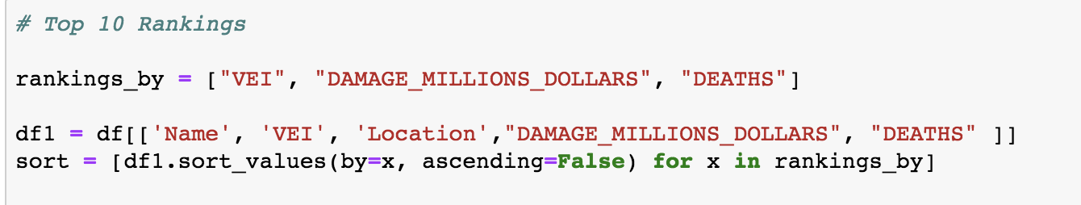
More Data Exploration
Notes:
Chloe Present

Slide 8
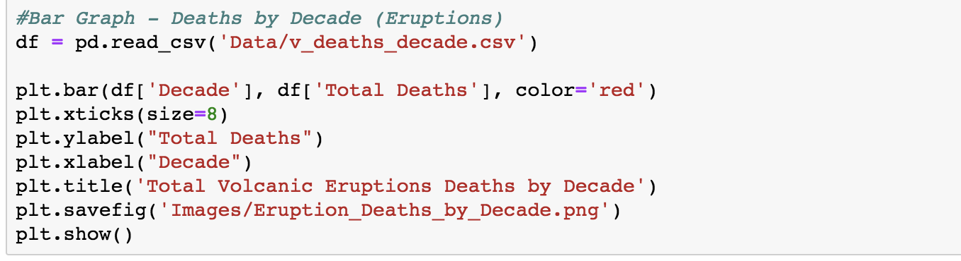
More Data Exploration & Analysis
Notes:
Chloe Present

Slide 9
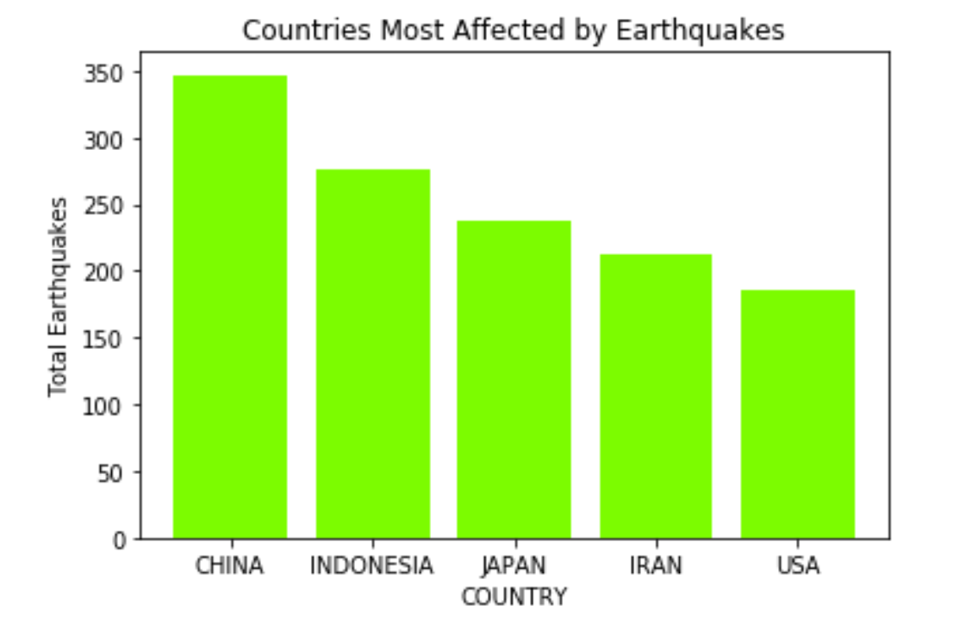
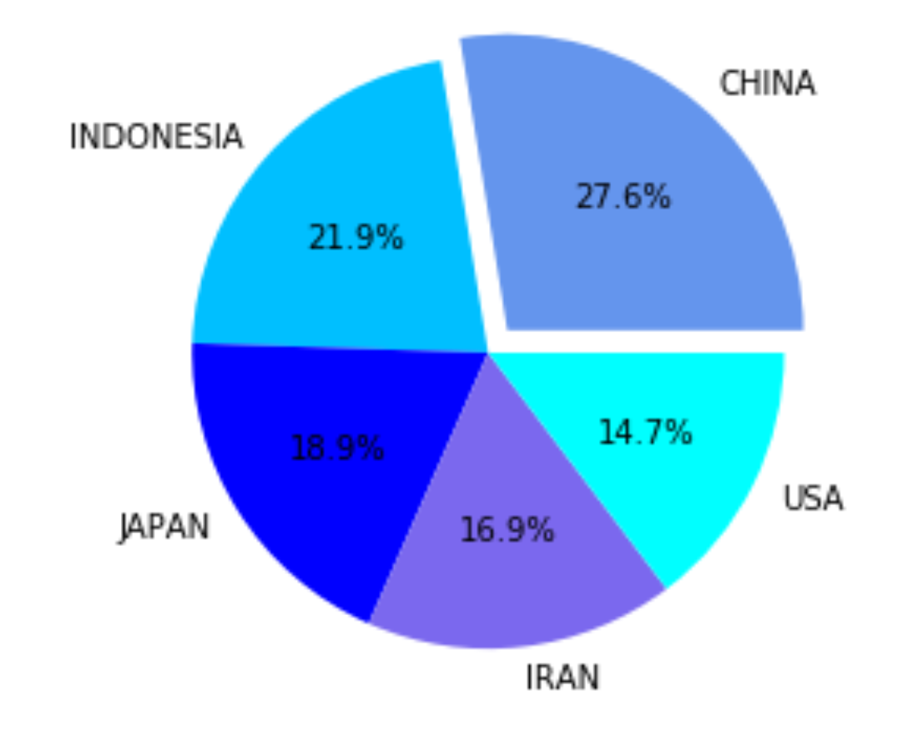
Top 5 Countries Affected by Earthquakes
Notes:
Aparna

Slide 10
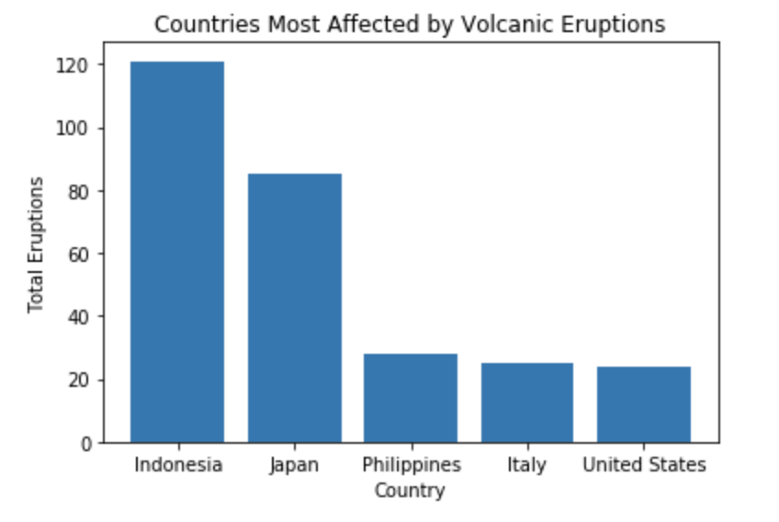
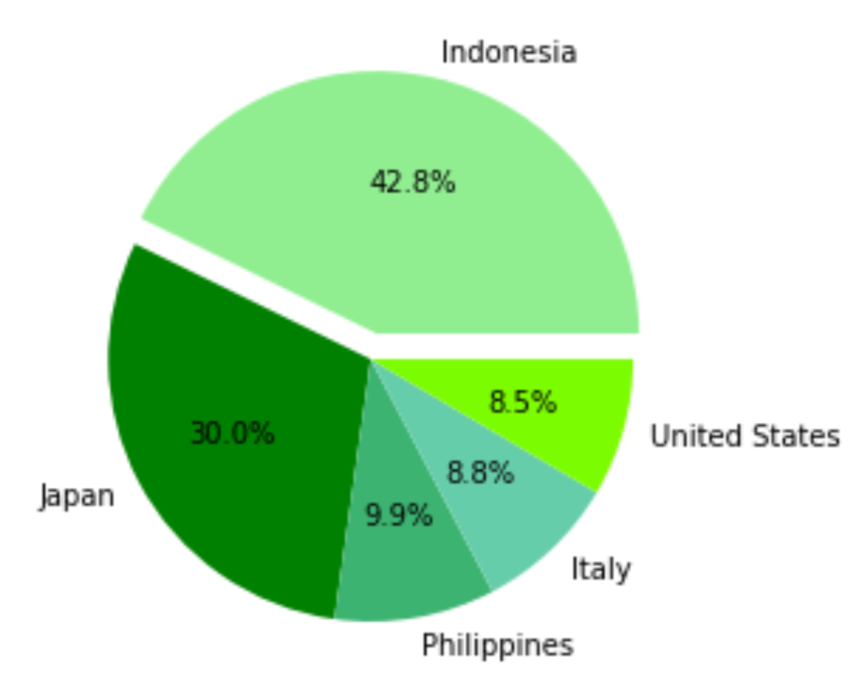
Top 5 Countries Affected by Volcanic Eruptions
Notes:
Aparna

Slide 11
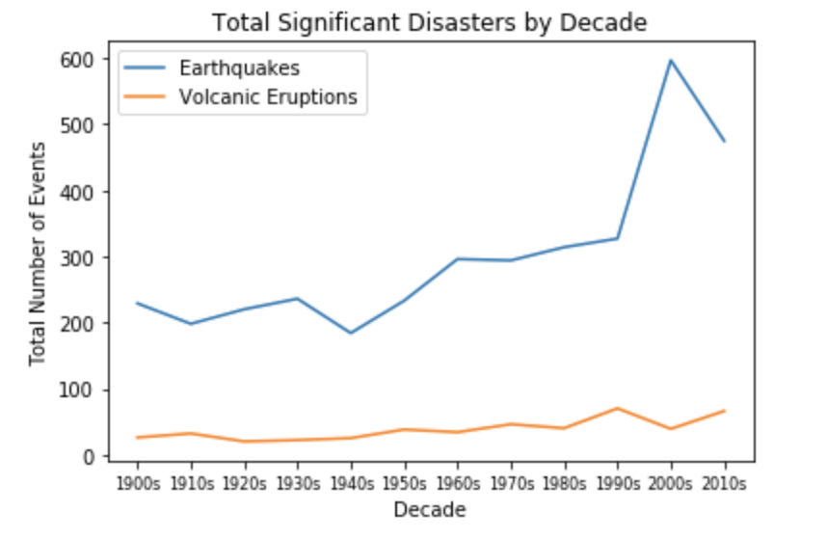
Earthquakes & Volcanic Eruptions by Decade
Notes:
BJ Present
Most EQs = 2000s had 597
Most Eruptions = 1990s had 70

Slide 12
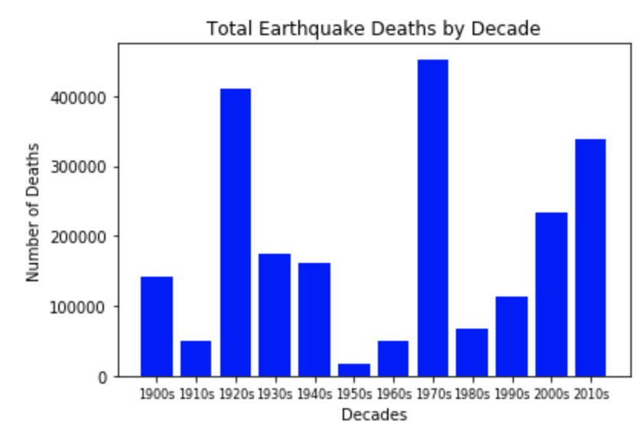
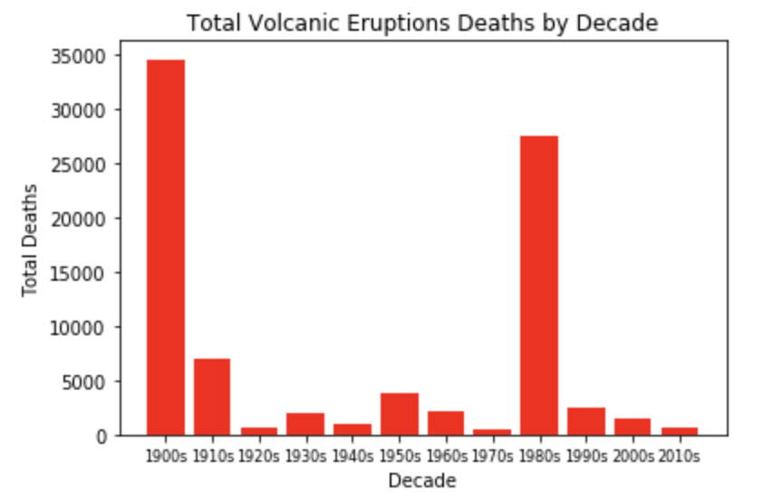
Deaths by Decade
EARTHQUAKE
VOLCANIC ERUPTIONS
Notes:
BJ Present

Slide 13
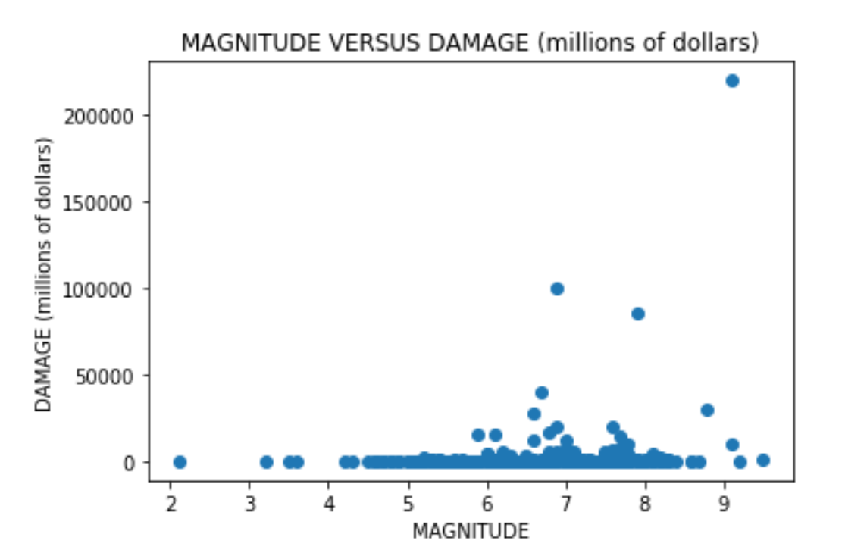
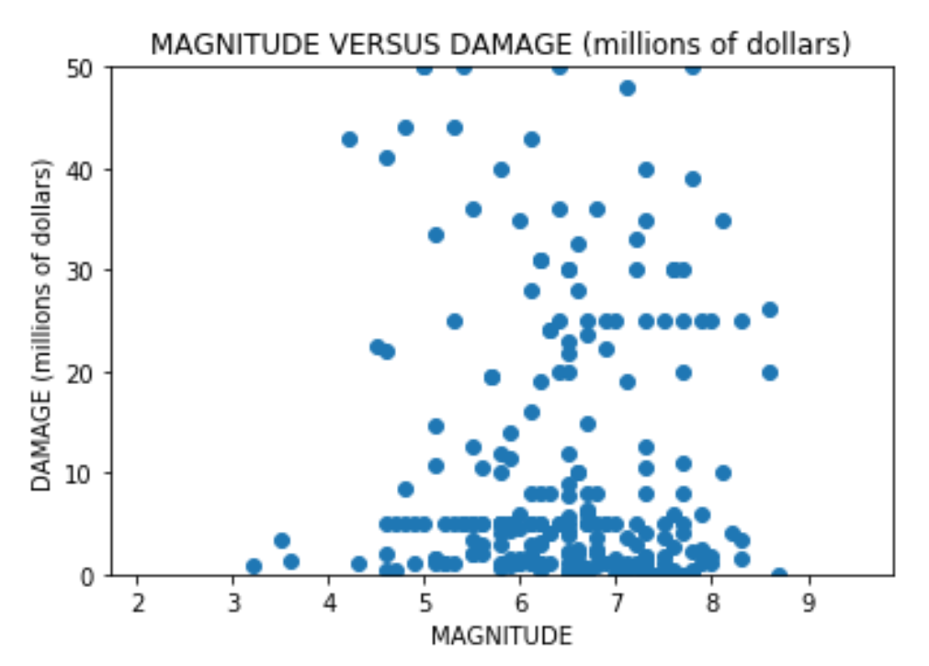
Earthquake Damage ($) by Magnitude
Notes:
BJ Present

Slide 14
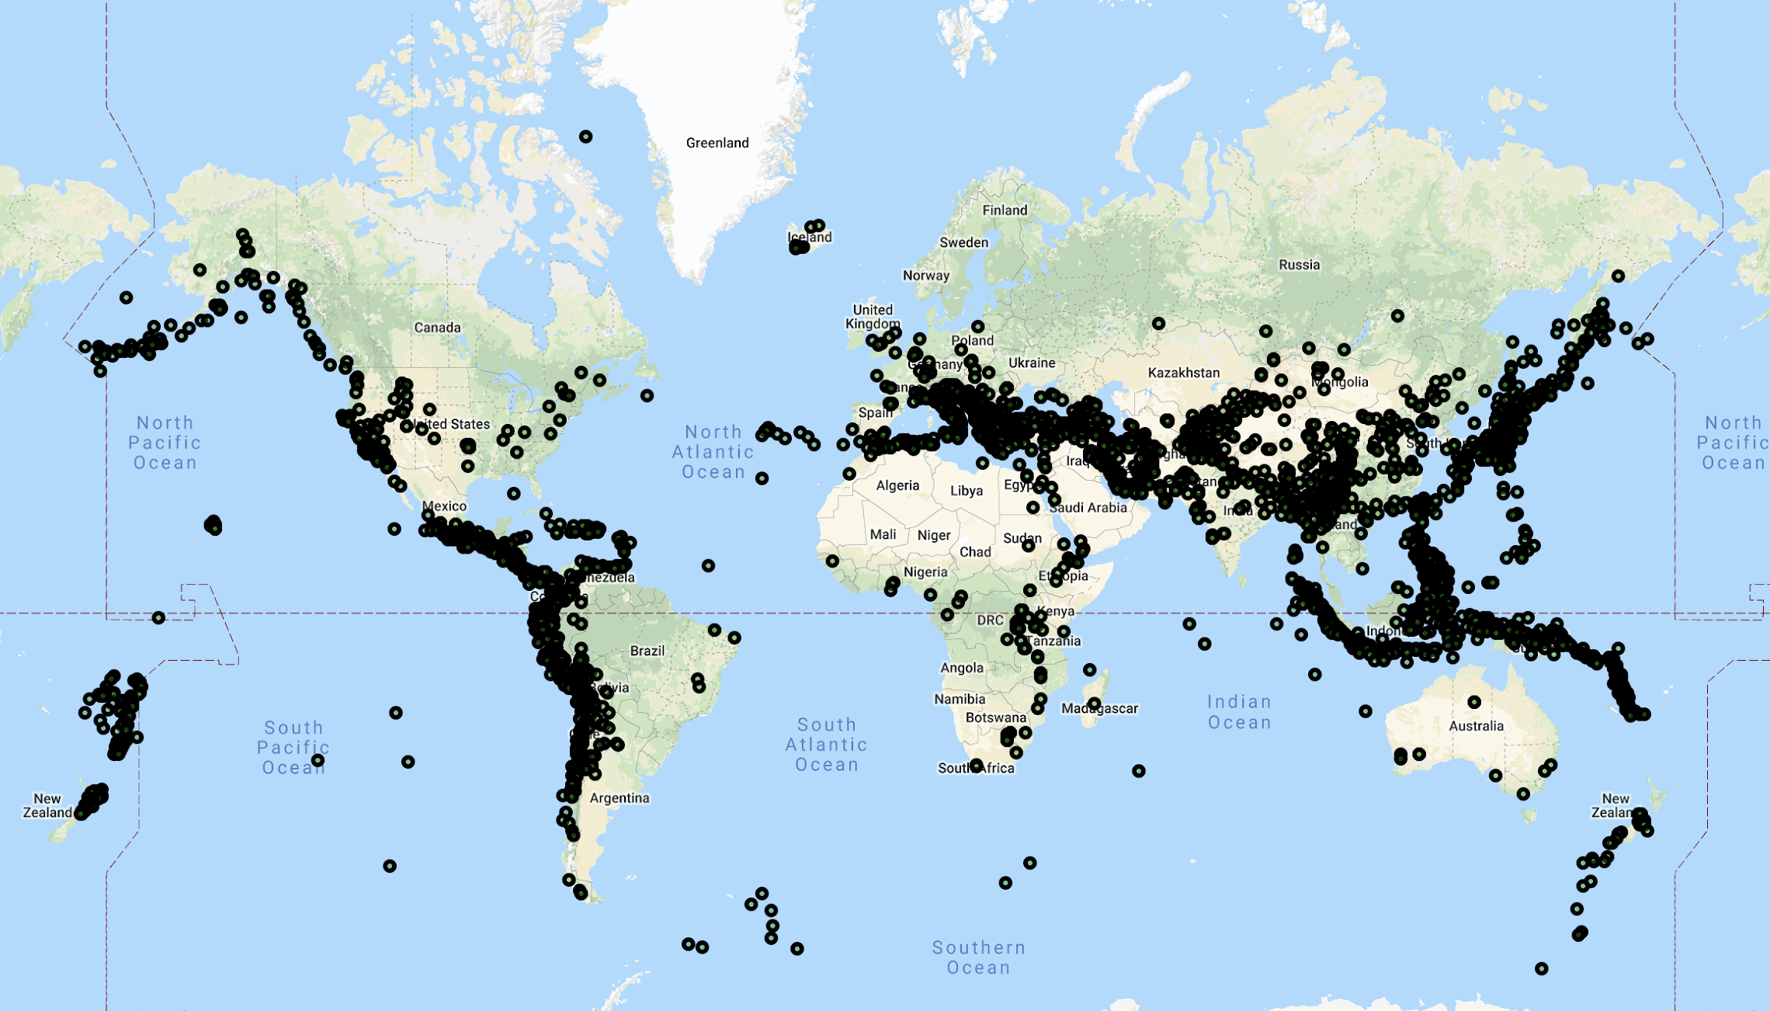
EARTHQUAKES AROUND THE WORLD
Notes:
Adote Present

Slide 15
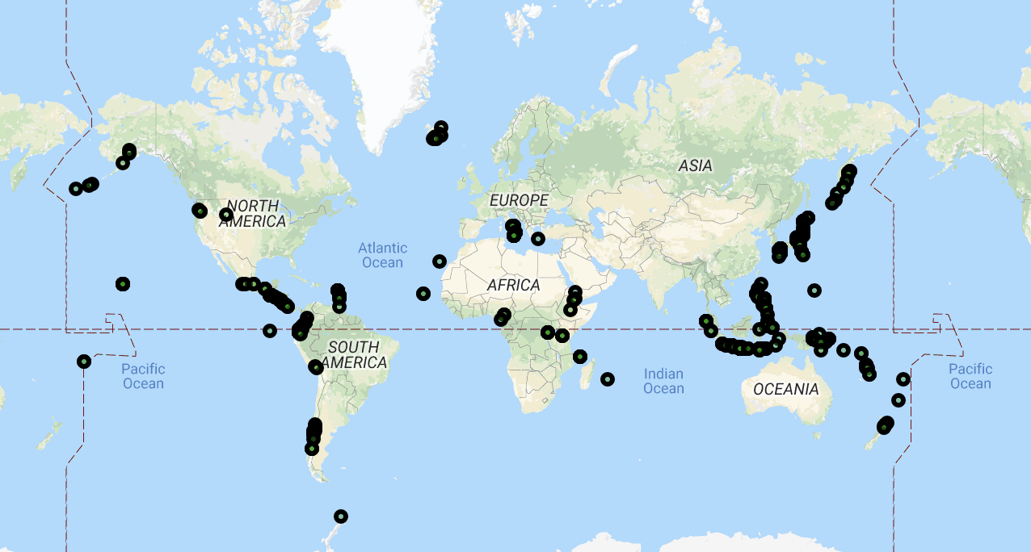
VOLCANIC ERUPTIONS AROUND THE WORLD
Notes:
Adote Present

Slide 16
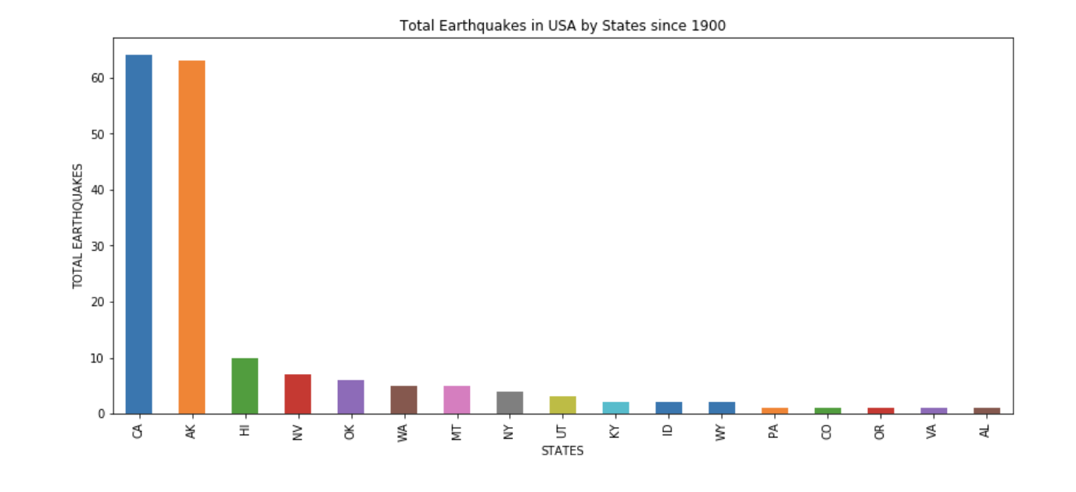
Earthquakes in the United States
Notes:
Adote Present

Slide 17
Implications of Findings
Among the top five countries affected by the two disasters, Indonesia, Japan and USA are highly affected by both.
There are fewer volcanic eruptions than earthquakes during the period analyzed.
Earthquakes caused the most deaths in the 1970s while volcanic eruptions caused the most deaths in the 1900s. Earthquake deaths around 10x volcanic eruption deaths.
In general, as the magnitude of a disaster increases, the damage increases.
Notes:
Aparna Present

Slide 18
THANK YOU !
ANY QUESTIONS ?

